Slide 1
WEBMONK (DAY - 3) 💻
Topics covered:
* All about git & GitHub

Slide 2
GIT

Slide 3
SO WHAT IS THIS GIT?
Git is an example of a distributed version control system (DVCS) commonly used for open source and commercial software development.
DVCSs allow full access to every file, branch, and iteration of a project, and allows every user access to a full and self-contained history of all changes.
Unlike once popular centralized version control systems, DVCSs like Git don’t need a constant connection to a central repository.
Developers can work anywhere and collaborate asynchronously from any time zone.
Seeing a transparent history of changes, who made them, and how they contribute to the development of a project helps team members stay aligned while working independently.

Slide 4
LET’S DEFINE OURSELVES FIRST TO GIT
git config --global user.email "you@example.com"
git config --global user.name "Your Name"

Slide 5
LOCAL FIRST
first lets make a git folder in our computer
git init
add file to the tracking:
git add index.html (for single file)
git add . (for multiple file)
to commit all changes: git commit -m “new file added” index.html
if you don’t provide file after the comment, everything you have done will be committed. For ex: git commit -m “new code added”

Slide 6
IGNORE TRACKING ?
create a file called .gitignore
write the file names that should be ignored by git
commit the file

Slide 7
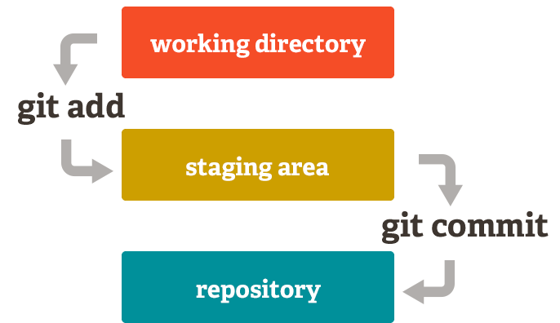

Slide 8
GIT LOGS
git log - shows the logs of git
this logs consist of commit logs.
these contains information like:
commit id
author
date
commit message
file changes (--stat)

Slide 9
REMOVE A FILE
git rm somefile.txt
git commit –m ‘removed’
git push origin

Slide 10
GITHUB

Slide 11
AND WHAT IS THIS GITHUB?
GitHub is a Git repository hosting service, but it adds many of its own features. While Git is a command line tool, GitHub provides a Web-based graphical interface. It also provides access control and several collaboration features, such as a pull requests, issues, wikis and basic task management tools for every project.

Slide 12
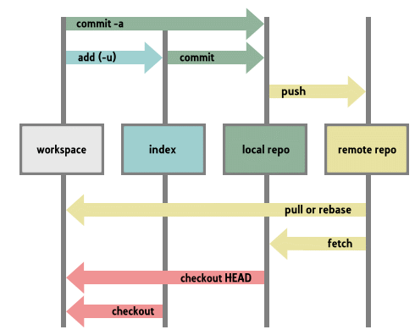

Slide 13
PULLING A REPOSITORY/EDITING
lets pull a repository from GitHub
git clone https://github.com/open-devs/test
git remote add origin https://github.com/open-devs/test
edit the file a.txt
git commit –am ‘something added’
git push

Slide 14
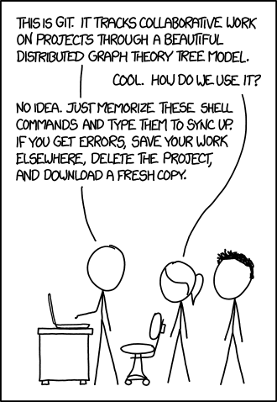
THANK YOU
let’s head over to VS Code to see the magic…

